Slide 1
Switched / Fast / Gigabit Ethernet

Slide 2
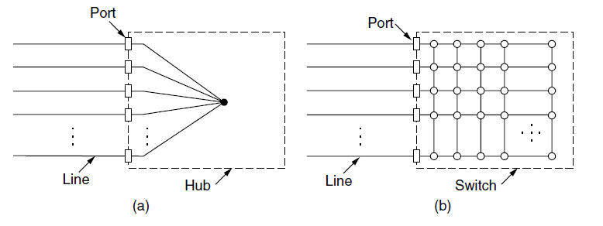
Switched Ethernet (1)
Hub. (b) Switch.
Switches isolate ports
Greater throughput for multiple ports

Slide 3
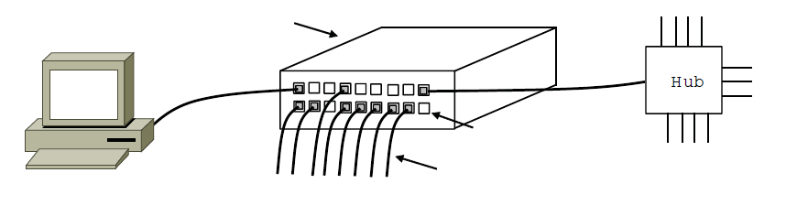
Switched Ethernet (2)
Switch
Hub
Switch ports
Twisted pair

Slide 4
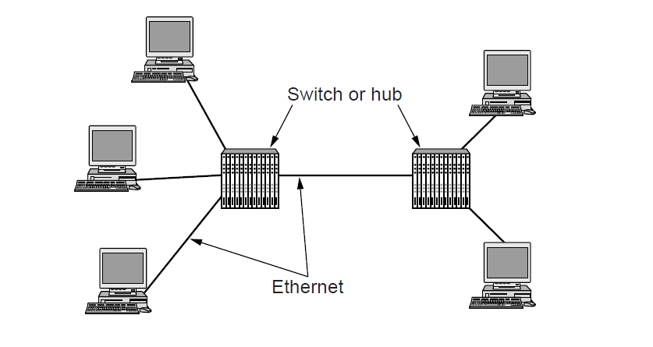
Gigabit Ethernet
Commonly over twisted pair
10GB Eth deployed in places

